Slide 1
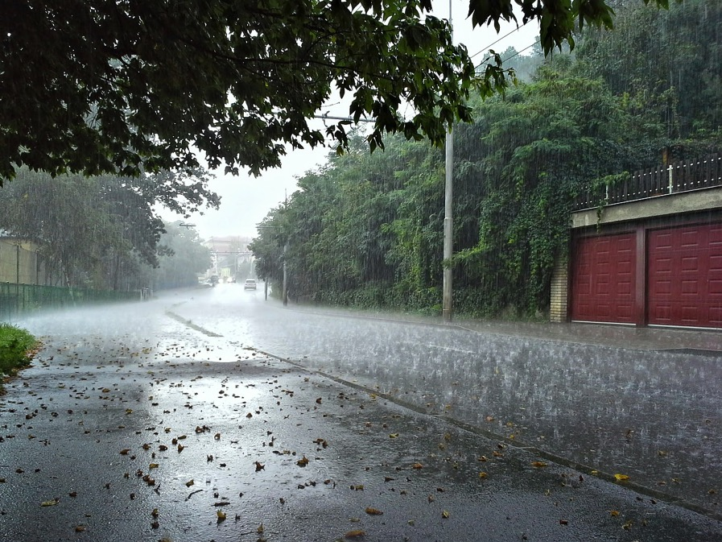
Measuring
weather

Slide 2
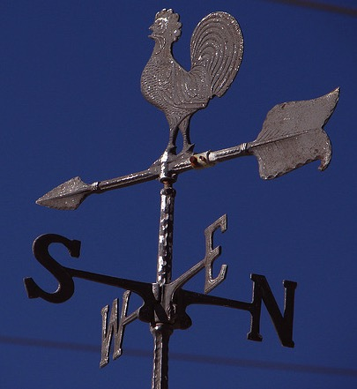
Weather vane
Robbie T, 2006, Weather vane, https://www.flickr.com/photos/rawb/84614158/ CC BY 2.0 https://creativecommons.org/licenses/by/2.0/ (cropped)

Slide 3
Weather vane — for measuring wind direction direction
The wind catches on the arrow and turns it to point in the direction the wind is blowing.
Robbie T, 2006, Weather vane, https://www.flickr.com/photos/rawb/84614158/ CC BY 2.0 https://creativecommons.org/licenses/by/2.0/ (cropped)

Slide 4
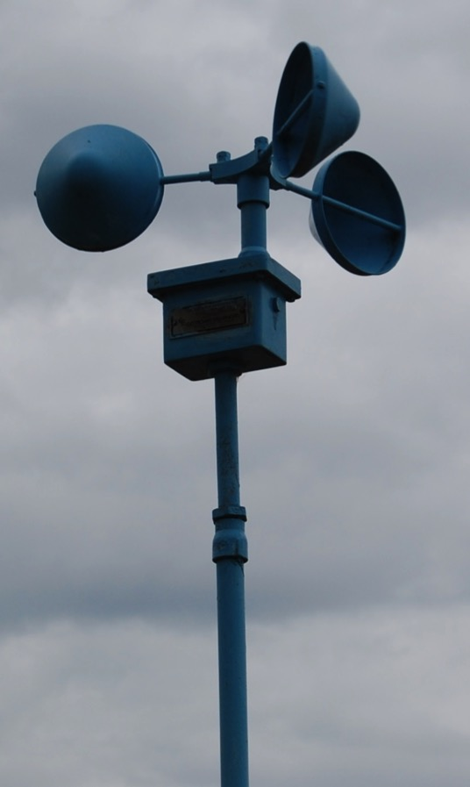
Anemometer
Badrinath M, 2007, Anemometer, https://www.flickr.com/photos/badrri/1310135462/ CC BY 2.0 https://creativecommons.org/licenses/by/2.0/ (cropped)

Slide 5
Anemometer — for measuring wind speed
Can be fixed or handheld.
Wind is caught in the cups making them spin. The greater the wind the faster the cups will spin.
Badrinath M, 2007, Anemometer, https://www.flickr.com/photos/badrri/1310135462/ CC BY 2.0 https://creativecommons.org/licenses/by/2.0/ (cropped)

Slide 6
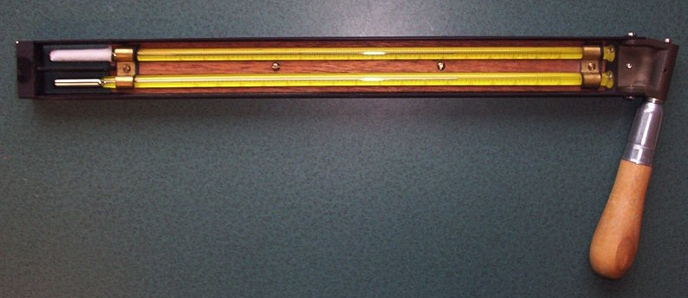
Psychrometer — a type of hygrometer

Slide 7
Psychrometer — for measuring humidity
A sling psychrometer is used to measure the moisture in the air.

Slide 8
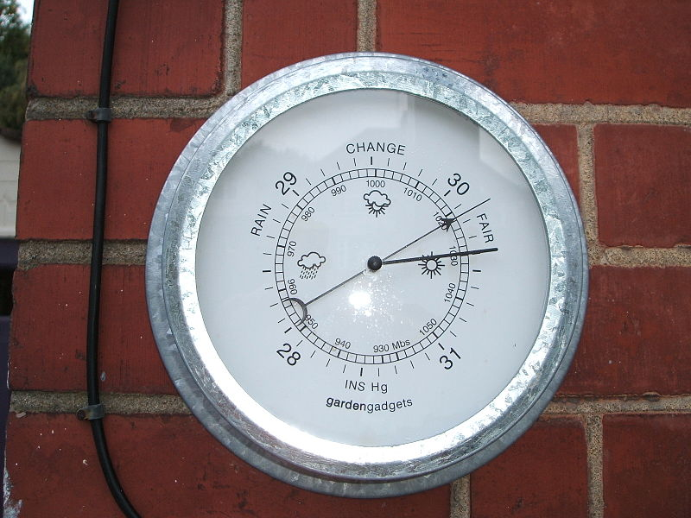
Barometer

Slide 9
Barometer — used to measure air pressure
Barometers respond to changes in air pressure. It can indicate the likelihood of a change in the weather. When air pressure is high it is a sign of good weather.

Slide 10
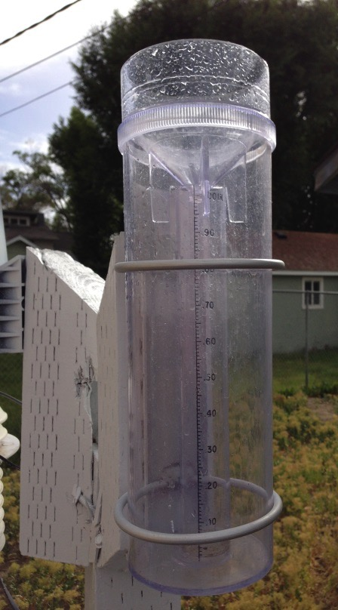
Rain gauge
Famartin 2013, A 4inch plastic rain gauge typical of those used by the CoCORaHS program https://commons.wikimedia.org/wiki/File%3A2013-06-24_17_39_11_A_4-inch_plastic_rain_gauge_typical_of_those_used_by_the_CoCoRaHS_program.jpg CC BY-SA 3.0 http://creativecommons.org/licenses/by-sa/3.0

Slide 11
Rain gauge — used to collect data about rainfall
Rain gauges collect rain as it falls in a measuring container. This can be read to indicate the amount of rainfall that has occurred over a period of time.
Some weather stations have automatic rain gauges in them which will electronically record and send the data and then empty the gauge ready for the next collection.
Famartin 2013, A 4inch plastic rain gauge typical of those used by the CoCORaHS program https://commons.wikimedia.org/wiki/File%3A2013-06-24_17_39_11_A_4-inch_plastic_rain_gauge_typical_of_those_used_by_the_CoCoRaHS_program.jpg CC BY-SA 3.0 http://creativecommons.org/licenses/by-sa/3.0

Slide 12
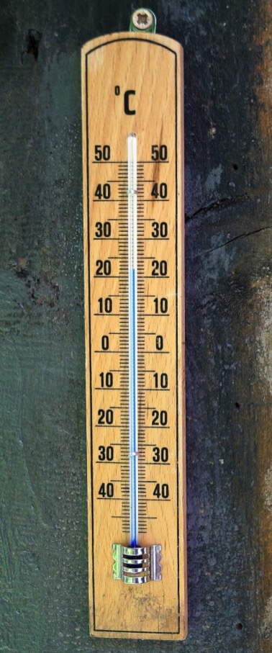
Thermometer

Slide 13

Thermometer — used to measure air temperature
In traditional thermometers heat in the air causes the liquid inside the thermometer to expand. This means that the liquid level in the thermometer rises allowing us to read the temperature.

Slide 14
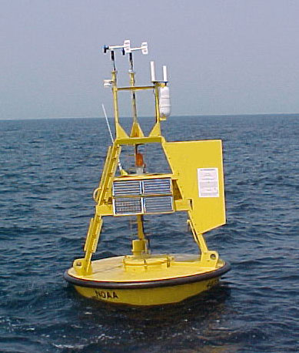
Weather buoy

Slide 15
Weather buoy — for collecting weather data in the ocean
Weather buoys contain a range of different instruments for measuring the weather.
They collect data about:
air temperature
wind speed
wind direction
air pressure.
This information is often sent by radio or satellite to be used for monitoring or predicting weather patterns.

Slide 16
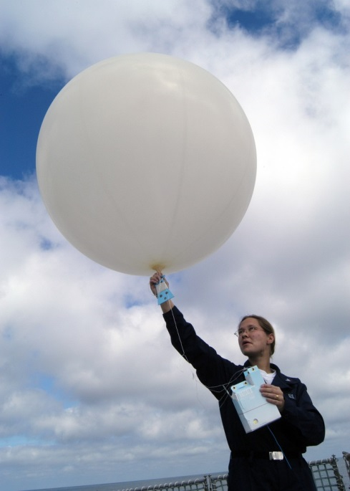
Weather balloons

Slide 17
Weather balloons — for collecting weather data in the atmosphere
Weather balloons carry instruments to collect data high in the atmosphere.
They collect information about:
air pressure
temperature
moisture in the air
wind speed.

Slide 18
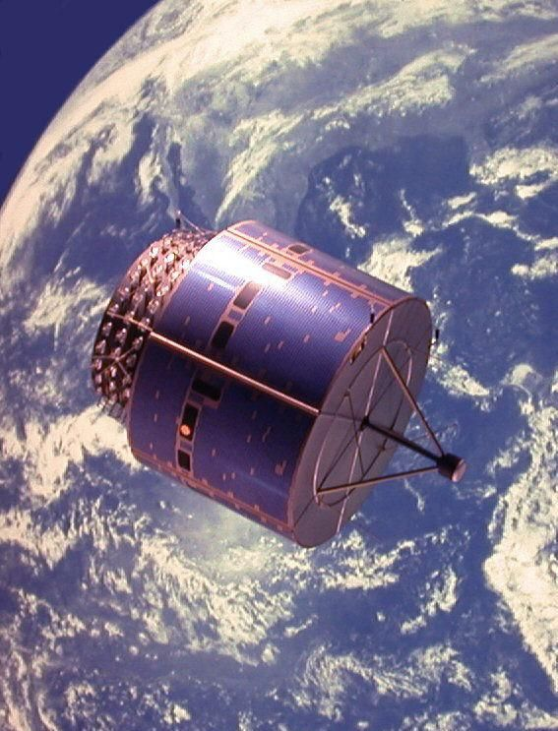
Weather satellite

Slide 19
Weather satellite — for monitoring Earth’s weather and climate
Weather satellites monitor Earth from space. They are used to monitor weather patterns on a large scale and predict weather events such as cyclones.

Slide 20
Image Attributions
Slide 1: jingob, 2014, rain-raindrops-water-wet-weather, https://pixabay.com/en/rain-raindrops-water-wet-weather-462828/ CC0 Public domain
Slide 2&3: Robbie T 2006, Weather Vane, https://www.flickr.com/photos/rawb/84614158/ CC BY 2.0 https://creativecommons.org/licenses/by/2.0/ (cropped)
Slide 4&5: Badrinath M, 2007 Anemometer https://www.flickr.com/photos/badrri/1310135462/ CC BY 2.0 https://creativecommons.org/licenses/by/2.0/ (cropped)
Slide 6&7: Cambridge Bay Weather, 2005 Sling psychrometer https://commons.wikimedia.org/wiki/File:Sling_psychrometer.JPG CC0 Public domain
Slide 8&9: Barometer https://en.wikipedia.org/wiki/File:Barometer.JPG CC0 Public domain
Slide 10&11: Famartin 2013, A 4inch plastic rain gauge typical of those used by the CoCORaHS program https://commons.wikimedia.org/wiki/File%3A2013-06-24_17_39_11_A_4-inch_plastic_rain_gauge_typical_of_those_used_by_the_CoCoRaHS_program.jpg CC BY-SA 3.0 http://creativecommons.org/licenses/by-sa/3.0
Slide 13&14: Thermometer-degrees celsius-scale-temperature https://pixabay.com/en/thermometer-degrees-celsius-scale-799816/ CC0 Public domain
Slide 12&15: NOAA-NDBC-discus-buoy https://commons.wikimedia.org/wiki/File:NOAA-NDBC-discus-buoy.jpg#/media/File:NOAA-NDBC-discus-buoy.jpg
Slide 16&17: U.S. Navy photo by Photographer’s Mate 3rd Class Ramon Preciado. https://commons.wikimedia.org/wiki/File%3AUS_Navy_030222-N-8029P-001_Aerographer's_Mate_3rd_Class_Mandy_Fetterman_launches_a_100-gram_weather_balloon.jpg
Slide 18&19: Greg Goebel https://commons.wikimedia.org/wiki/File%3AWeather_Satellite.jpg

